Slide 1
IMPOSSIBILITY RESULT
In Anonymous Rings
GROUP 3:
Deepthi Vishwanath
Isha Pradhan

Slide 2
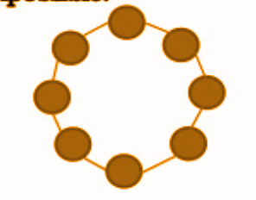
PROOF OF IMPOSSIBILITY RESULT
Anonymous leader election system is the one where processors do not have unique identifiers.
Symmetry between the processors is maintained and all processors start in the same state.
Since they execute the same state machine, they send the same messages in each round.
Thus they receive the same messages in each round and the state change for all of them is identical
Hence, if one of the processors is elected as a leader, then so are all of them.
Hence it is impossible to have an algorithm that elects a single leader.
Leader
Anonymous ring

